Slide 1
Examining the effects of plant associations and individual traits on neighboring Arthropod community dynamics
Matthew Willson, Nora Underwood, and Brian Inouye

Slide 2

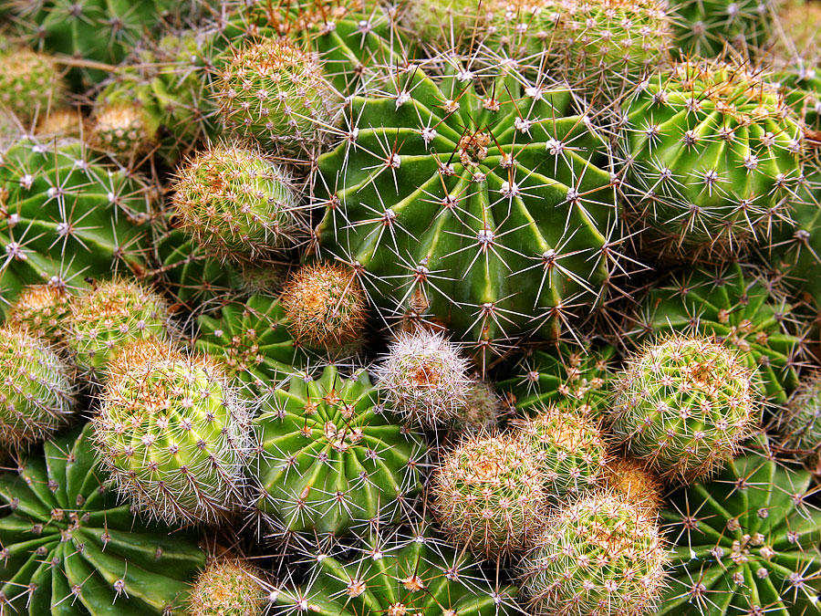
Traits of an individual plant can affect the magnitude of herbivory on a given plant
https://www.ecosia.org/images?q=plant+defenses#id=AA2438661F42979F3AA2F2AF5D5CB364DAE5A742
https://www.ecosia.org/images?q=posion+ivy#id=33259E91791CE62002113FA98DE3A96FDFE9B313

Slide 3
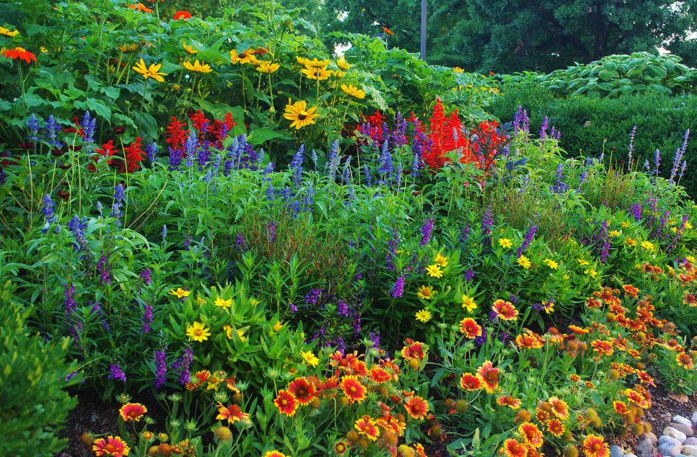
Traits of neighbors around a given plant can also affect the magnitude of herbivory
https://www.ecosia.org/images?q=plant+diversity#id=F9AF3BAD088BC28BC44099259268A3FE90F57D7D

Slide 4
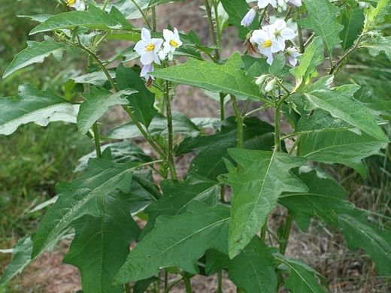
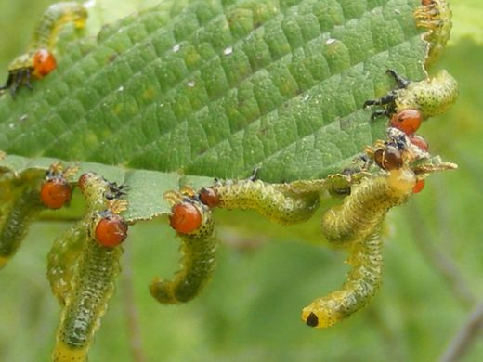
Associational Effects
Associational Susceptibility
Associational Resistance
https://www.ecosia.org/images?q=solanum+carolinense#id=3F62141014E07BF872F4BD6C958235F6AE2EADC4
https://www.ecosia.org/images?q=insect%20herbivory#id=A8BDE99BEF86F0ACAD357BDAD728FB41DB3DCAD0
Notes:
Specific plant associations may decrease or increase the probability of detection by, and/or vulnerability to, herbivores.

Slide 5
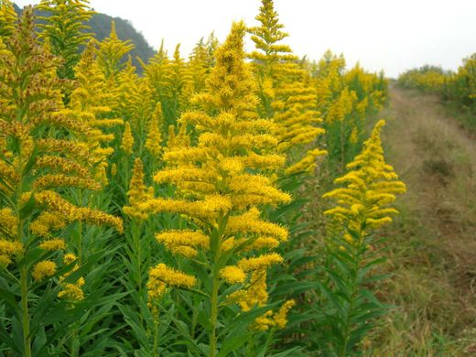
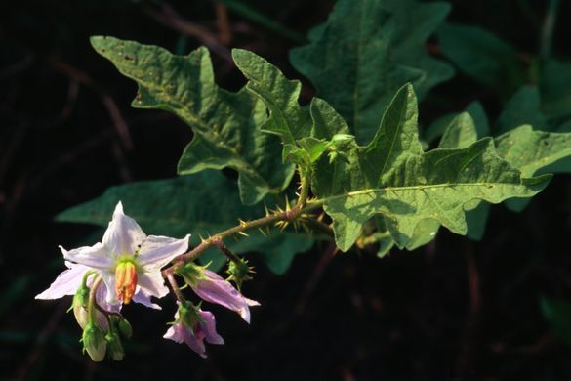
Focal Species
Solidago altissima
Solanum carolinense
https://www.ecosia.org/images?q=Solidago+altissima+#id=3E93D534CBA9D5ABFAA74A765B67A967E6D0C9C1
https://www.ecosia.org/images?q=solanum%20carolinense#id=9F560F889292C2F4AB872C10361830A5A785A357
Notes:
Previous studies found AE between SOCA and SOAL in terms of plant damage. Our study examined AE in terms of the abundance of arthropods

Slide 6
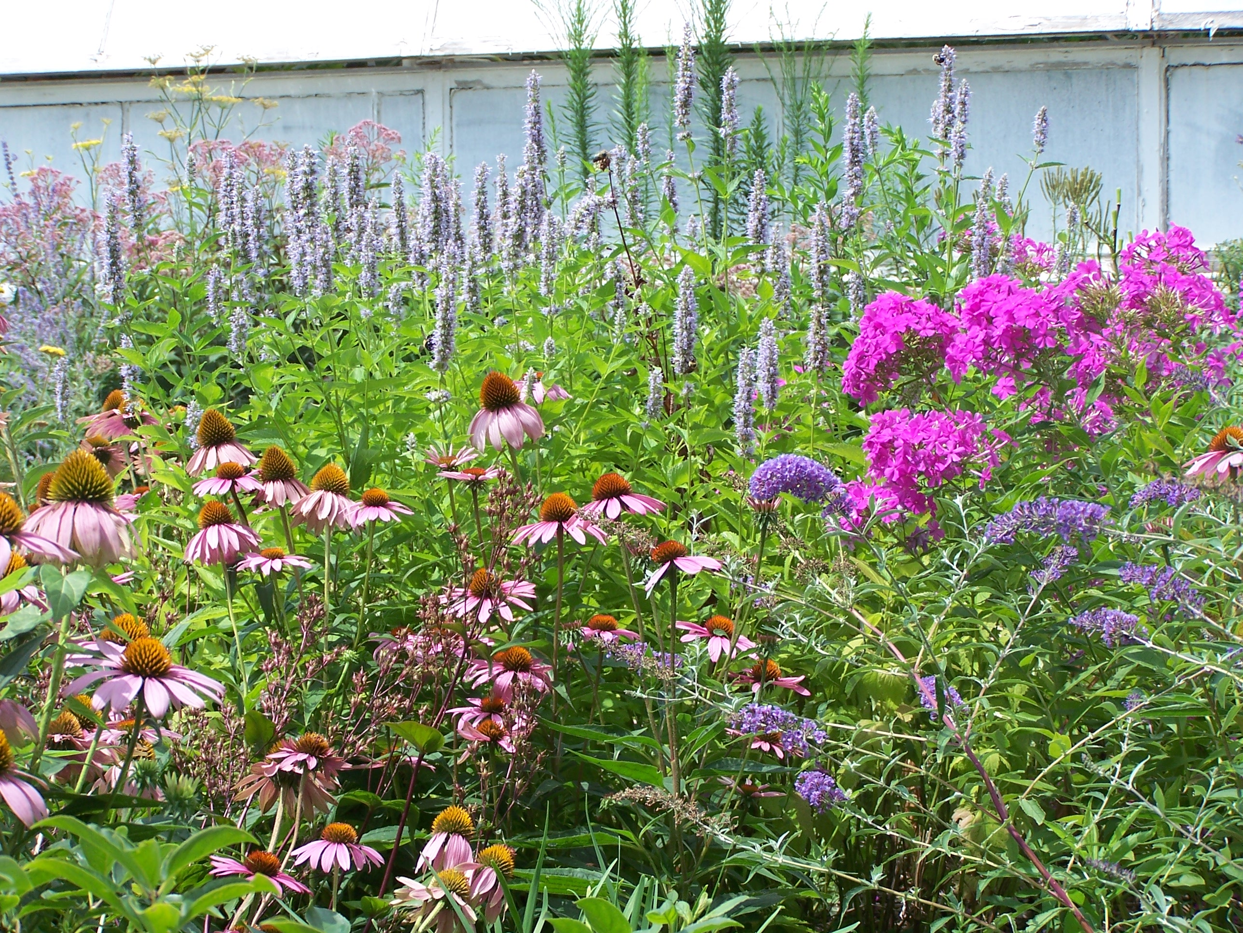
Big Question: How does the neighborhood around a given plant affect the arthropod community?
https://www.ecosia.org/images?q=plant+diversity#id=321739E1A8C6F6C6BC8D39482D935C50E11EA1CF
Notes:
Given that individual plant traits can affect the arthropod community

Slide 7
Specifically, do individual plant traits or neighborhood variables affect the Arthropod community?
Individual plant traits
Neighborhood variables
Plant size
Plant genotype
Con-specific plant density
Hetero-specific plant density
Plant frequency

Slide 8
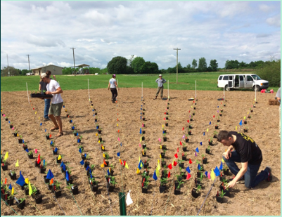
Methods
Varied plants along spokes which dispersed from the center
Plant type changes as one rotates around the fan, while the spacing of plants changes with distance from the center.
Counted all herbivore individuals
Counted all natural enemy individuals

Slide 9
Generated linear models
Individual plant traits
+
Neighborhood variables
Solanum herbivore abundance
Solidago natural enemy abundance
Solanum natural enemy abundance
Solidago herbivore abundance

Slide 10
Methods
Associational effects
Effects of con-specific plant density
Hetero-specific plant density
Hetero-specific plant frequency
Con-specific plant density

Slide 11
Larger plants had more Arthropods
Solanum
Solidago
Figure 1: Estimate = 0.0220565, T = 5.415, p = 1.03e-07. N = 434 plant individuals.
Figure 2: Estimate = 3.848e-03, T = 6.019, p = 3.72e-09. N = 434 plant individuals.

Slide 12
Larger plants had more Arthropods
Solanum
Solidago
Figure 3: Estimate = 7.259e-03 , T = 11.250, p < 2e-16. N = 434 plant individuals.
Figure 4: Estimate = 0.0015066 , T = 2.615, p = 0.00924. N = 434 plant individuals.

Slide 13
Areas of high Solanum density had more herbivores on Solanum
Figure 5: Estimate = -0.0025354, T = -3.184, p = 0.00156. N = 434 plant individuals.

Slide 14
Areas of high Solanum frequency had more herbivores on Solidago
Figure 6: Estimate = 1.575e+00, T = -2.037, p = 0.0423. N = 434 plant individuals.

Slide 15

There were no significant effects of plant genotype on Arthropod abundance
https://www.ecosia.org/images?q=dna#id=43E1B1486DAE08936572D103EB214F599C7F388D

Slide 16
Summary
Individual plant traits and neighborhood variables can both affect the abundance of Arthropods.
Large Solidago plants surrounded by many Solanum plants those of which are densely distributed had the most herbivores.
Results suggest associational susceptibly on Solidago exerted by Solanum.

Slide 17
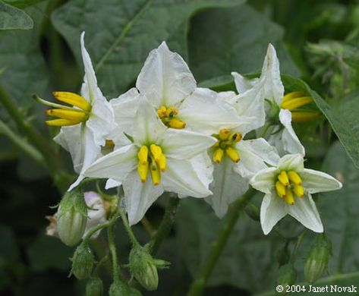
Future Studies
Examine potential effects on the abundance of natural enemies in the absence of herbivores.
Examine other plant traits that may affect the Arthropod community.

Slide 18

Acknowledgments
Nora Underwood
Brian Inouye
Underwood Lab
National Science Foundation (NSF)
https://www.ecosia.org/images?q=nsf#id=FF28A5DB14E9C0AE462A4C7DEDE3319E600F6DEA

Slide 19

Questions?
https://www.ecosia.org/images?q=question+#id=B2012651C902AD03B5ECB9EDA1B635B02F0BE758

